Slide 1

Citizen Weather Reporter
A crowdsourcing weather application
Satria Mitra Utama

Slide 2
Current Issues
Most weather forecast is accurate, but the real condition might be differ on each location
Radar and satellite images cannot capture real condition on the ground
The limited number of weather stations makes weather forecast verification slow

Slide 3
Benefits
Crowdsourcing can significantly increase the number of data points available for weather prediction
Crowdsourced data can offer real-time information on weather conditions, making it possible to track changes more quickly than with standard meteorological services.
Crowdsourcing weather data encourages community participation and engagement

Slide 4
Mock up Design
Welcome Page
Home
Maps
Publish a report
Crowsourced reports
Account

Slide 5
Home
Current weather based on locations
The source is from Met Office API https://www.metoffice.gov.uk/services/data/datapoint
Show current weather and forecast
Bottom Navigation Bar

Slide 6
Maps
Show the point of crowdsourced information
Use Google maps API / map box

Slide 7
Publish a report
Report weather around you
Choose weather type from a dropdown menu
Show your current location on maps
Take a picture or choose pictures from your phone of current weather

Slide 8
Crowdsourced Reports
Show crowdsourced weather reports from the user

Slide 9
Account
Show the user information and their submitted reports
Sign up and login page if they are not login yet

Slide 10
Data Input
User account
(username & password)
User input (string)
User input (image)
Update / display content
Met Office API
Google Maps API
Firebase database

Slide 11
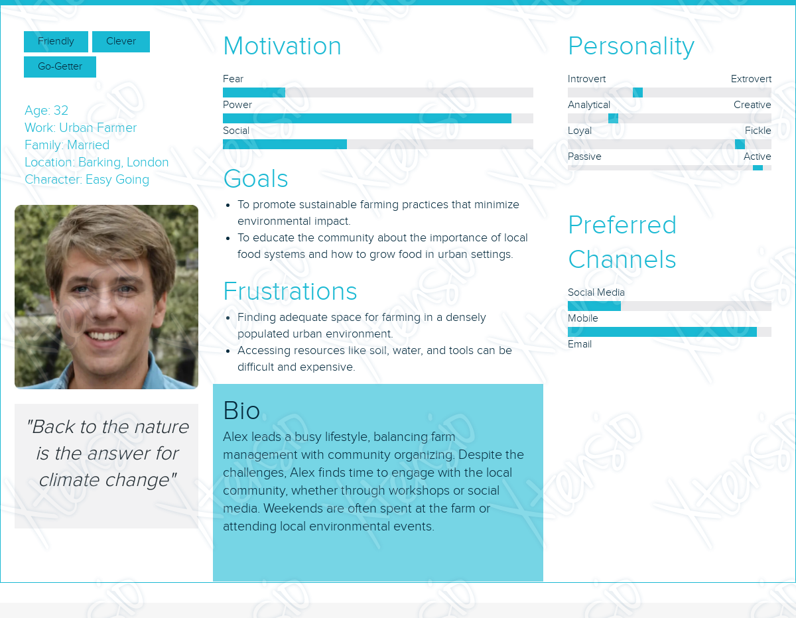
User Personas

Slide 12
notes
How do you connect this app with the theme of connected environments?
Collect the data and inform user based on their locations,
Collect mqtt data from weather stations
Inform user if there is an event happen around you e.g a tree fallen down
Inform user when the weather is going to worse
A welcome screen that ask you if you have weather stations, manual observation or not
Diagram/workflow
Login to mqtt to subscribe the topic
Publish the apps to the ce class so they can test it

Slide 13

Thank you
Any questions ?

